Slide 1
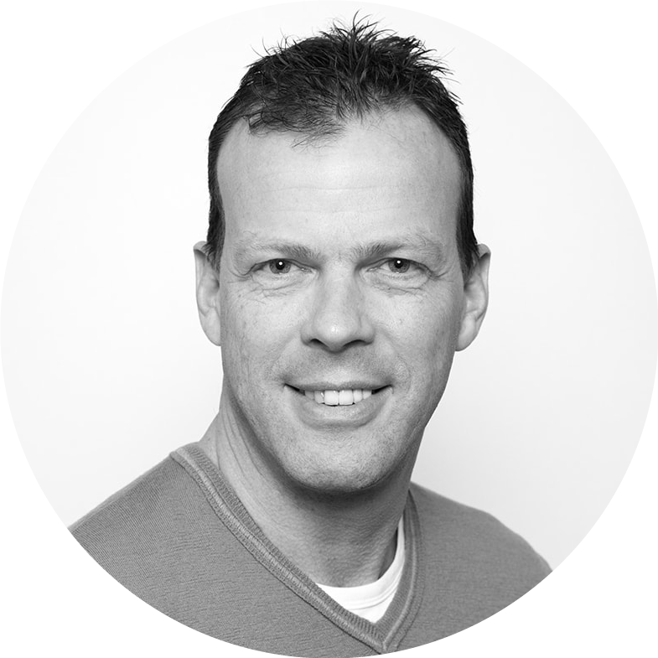
HOW TO START AN AMBASSADOR PROGRAM
Patrick de Pauw
CEO of Social Seeder

Slide 2
AGENDA
THIS EVENING
SOCIAL MEDIA CHALLENGE
INTRODUCTION TO AMBASSADOR MARKETING
HOW TO START AN AMBASSADOR PROGRAM
TAKE AWAYS
SOCIAL SEEDER I HOW TO START AN AMBASSADOR PROGRAM

Slide 3
SOCIAL MEDIA
CHALLENGE

Slide 4
” LET’S POST CONTENT ON SOCIAL MEDIA! ”
“ LET’S POST CONTENT
ON SOCIAL MEDIA ”
ORGANIC REACH
2013
2017
12 %
1-2 %
SOCIAL SEEDER I HOW TO START AN AMBASSADOR PROGRAM

Slide 5
“ PAY TO PLAY ”
2010
2013
2017
1000 Followers
1000
reach
500
reach
100
reach
SOCIAL SEEDER I HOW TO START AN AMBASSADOR PROGRAM

Slide 6
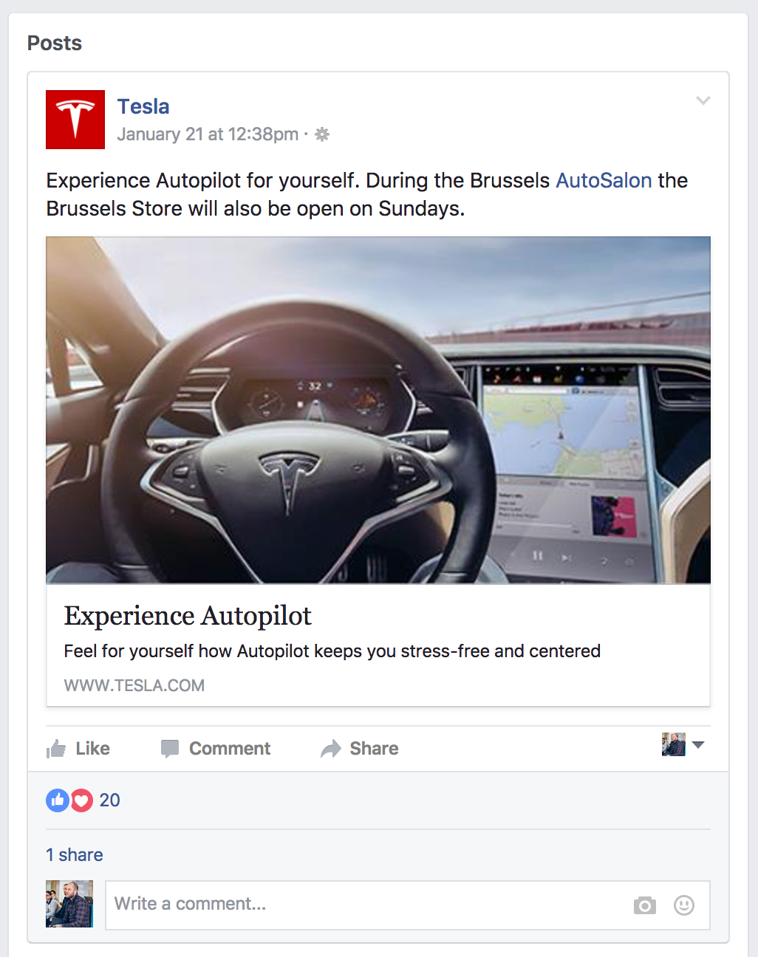
SOCIAL SEEDER I HOW TO START AN AMBASSADOR PROGRAM
Notes:
Objectives: Awareness / Image / Conversion / Retention (employee, clients)

Slide 7
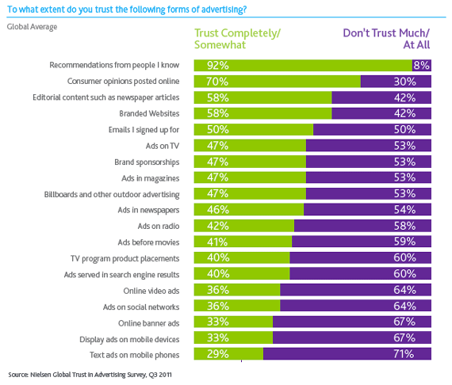
92%
36%
SOCIAL SEEDER I HOW TO START AN AMBASSADOR PROGRAM
Notes:
Think how small business where doing business before: Bouche à oreille was their marketing weapon. Tell also about the milk man story and food delivery…

Slide 8
” LET’S POST CONTENT ON SOCIAL MEDIA! ”
5000%
SOCIAL SEEDER I HOW TO START AN AMBASSADOR PROGRAM
Notes:
Influencer marketing

Slide 9
” LET’S POST CONTENT ON SOCIAL MEDIA! ”
170 Clients
8,000+ Campaigns
80% Active Ambassadors

Slide 10
“ WHY DOES IT WORK ”
?
HIGHER EFFECTIVENESS
Traditional marketing isn’t enough
BROADER REACH
You’re not the only one spreading the news
People are far more likely to trust messages from friends over any type of brand communication
HIGHER IMPACT
MORE ENGAGEMENT
People really feel part of the cause
SOCIAL SEEDER I HOW TO START AN AMBASSADOR PROGRAM

Slide 11
HOW TO STARTON
AN AMBASSADOR
PROGRAM

Slide 12
STEPS TO GET STARTED
ESTABLISH GOALS
IDENTIFY AMBASSADORS
SEGMENT THEM
CREATE DISPROPORTIONAL CONTENT
SOCIAL SEEDER I HOW TO START AN AMBASSADOR PROGRAM
Notes:
Objectives: Awareness / Image / Conversion / Retention (employee, clients)

Slide 13
“ GOALS ”
IMAGE
RETENTION
AWARENESS
CONVERSION
…
SOCIAL SEEDER I HOW TO START AN AMBASSADOR PROGRAM

Slide 14
“ IDENTIFY AMBASSADORS”
GLOBAL
IMAGE
HIGH
BRAND
AMBASSADORS
INFLUENCERS
IMPACT
COSTS
BLOGGERS
FANS / PARTNERS / BRAND LOVERS
EMPLOYEES
EMPLOYEES
LOCAL
RECOMMENDATION
LOW

Slide 15
“IDENTIFY AMBASSADORS”
LATENT
SEEDERS
POWER AMBASSADORS
RECEIVE
ENGAGE
SHARE
INPUT
BECOME ONE
VIEW
DISCOVER
LIKE
FOLLOW
RETWEET
REBLOG
COMMENT
HASHTAG
CREATE
I KNOW
I LIKE
I SEED
I ACT
I FEED
SOCIAL SEEDER I HOW TO START AN AMBASSADOR PROGRAM

Slide 16
“ CONTENT: STRATEGY’S FUEL ”
AMPLIFICATION
CHANNELS
CONTENT
RELEVANT
ADAPTED
TARGETED
SOCIAL SEEDER I HOW TO START AN AMBASSADOR PROGRAM

Slide 17
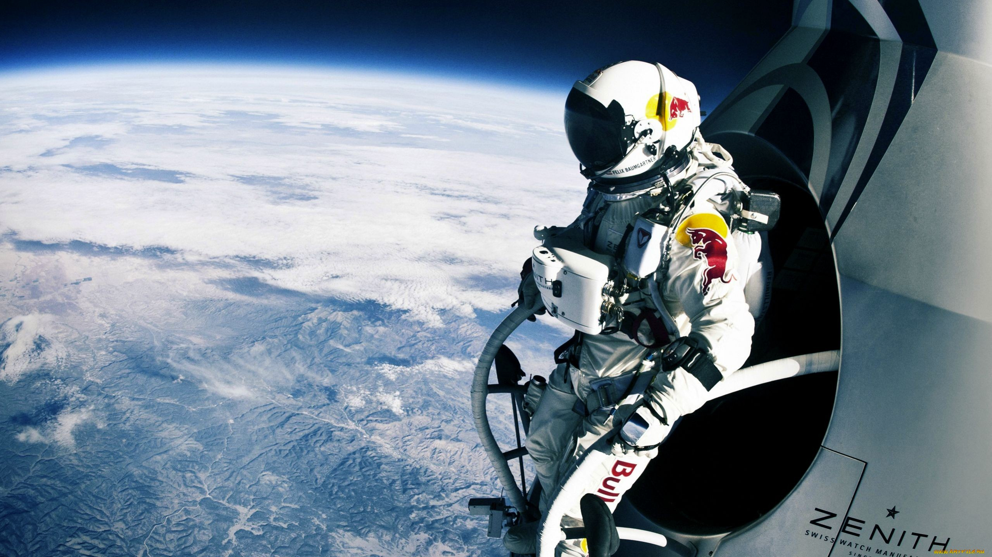
“ CONTENT: STRATEGY’S FUEL ”
HUMAN INTEREST
EXPERTISE
TOP TOPICALS
LOCAL CONTENT
NOSTALGIA
PRODUCT MARKETING
BEHIND THE SCENES
ANTICIPATE
ACTUALITY
“NEW(S)”!
THIRD PARTY CONTENT
SOCIAL SEEDER I HOW TO START AN AMBASSADOR PROGRAM

Slide 18
BRING EVERYTHING
TOGETHER
ON 1 PAGE

Slide 19
“ AMBASSADORS CANVAS ”
GOALS OF THE PROGRAM
STRUCTURE OF THE PROGRAM
WHO IS OUR AMBASSADOR?
PROJECT OWNERSHIP
AMBASSADOR PROGRAM NAME
KPI’S
FREQUENCY OF ASKING & GIVING
WHAT WE WILL GIVE OUR AMBASSADOR
WHAT WE WILL ASK OUR AMBASSADOR
RECRUITMENT OF AMBASSADORS

Slide 20
“ AMBASSADORS CANVAS EXAMPLE ”
Recruit new colleagues for the HR department
with a specific profile
in a low cost but highly efficient way
Activate departments composed
into teams with Star Wars
themed names
GOALS OF THE PROGRAM
STRUCTURE OF THE PROGRAM
WHO IS OUR AMBASSADOR?
All our employees
HR department
PROJECT OWNERSHIP
DATAFLOW
2 new colleagues
in 3 weeks
KPI’S
The team with the
best analytics would
receive teambuilding budget:
Weekend in the Ardennes
Ambassadors to spread
several campaign
messages through s
ocial media platforms:
Facebook, LinkedIn,
Twitter, Google+,…
Via email & coffee talks
2 campaigns per week
FREQUENCY OF ASKING & GIVING
WHAT WE WILL ASK OUR AMBASSADOR
WHAT WE WILL GIVE OUR AMBASSADOR
RECRUITMENT OF AMBASSADORS

Slide 21
HOW TO
MAKE IT HAPPEN

Slide 22
ACTIVATION FRAMEWORK
RECRUITMENT
MESSAGE
LEARN & OPTIMISE
REACH
SHARE

Slide 23
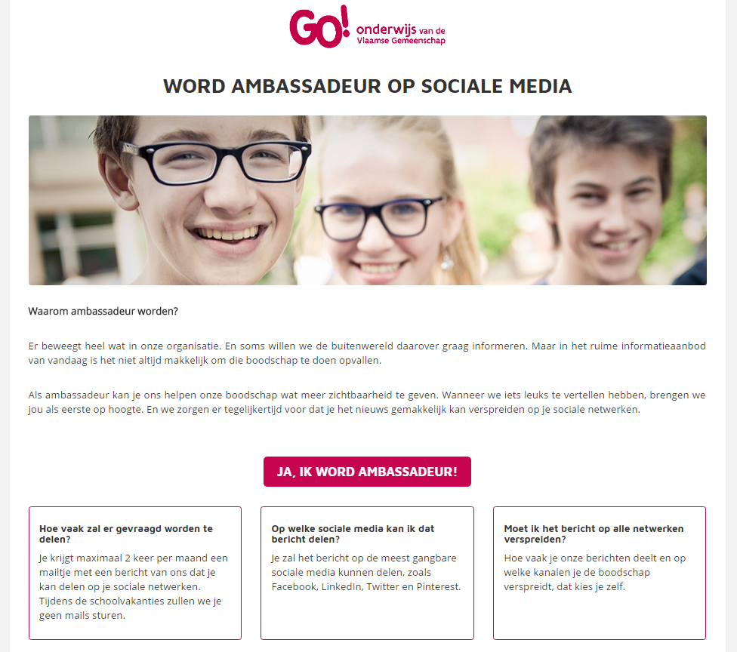

Slide 24
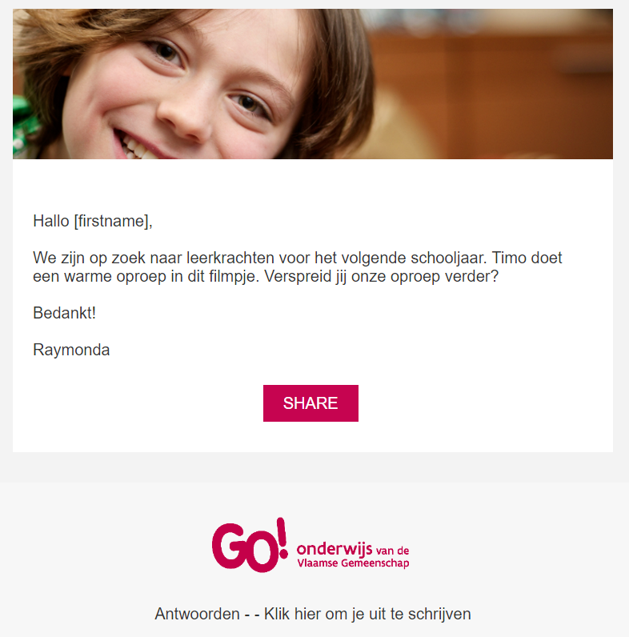

Slide 25
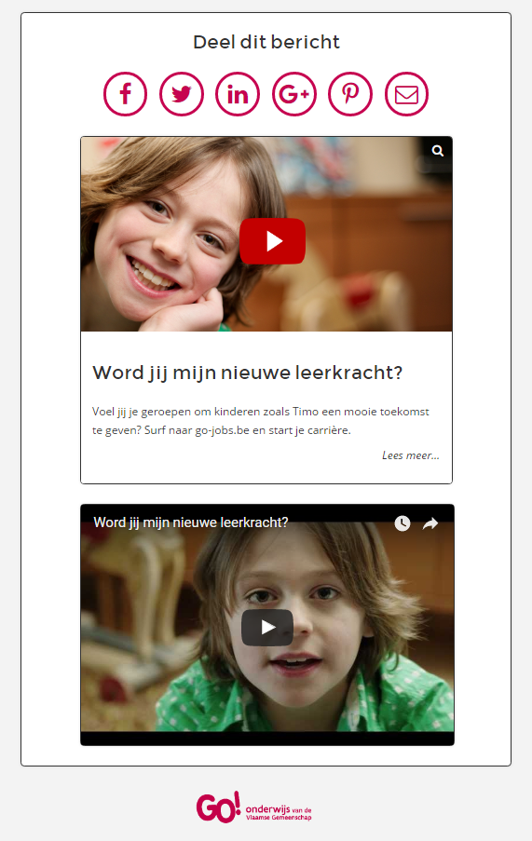

Slide 26
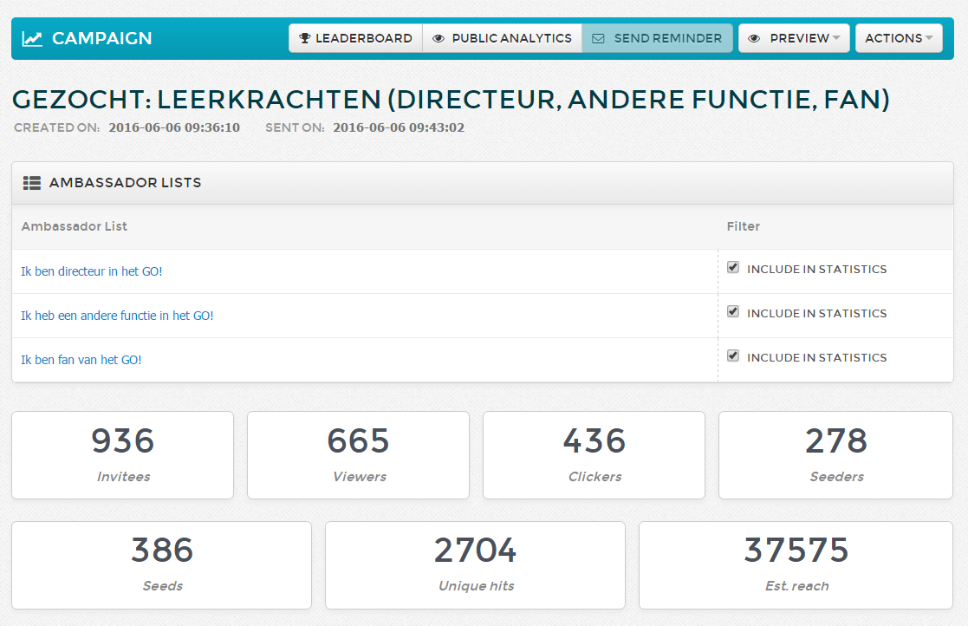

Slide 27
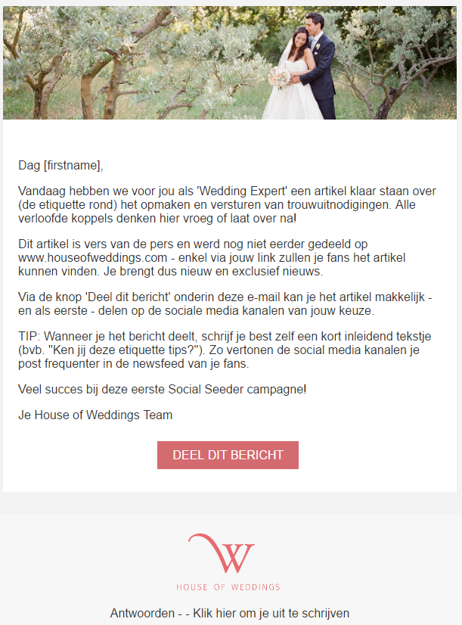

Slide 28
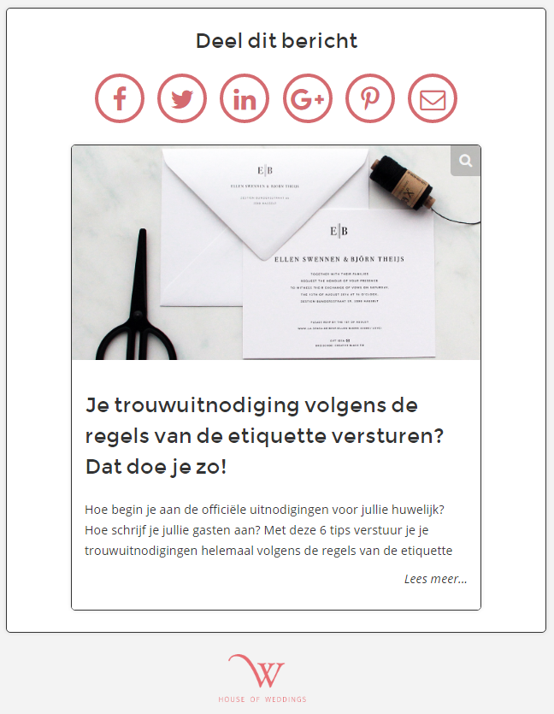

Slide 29
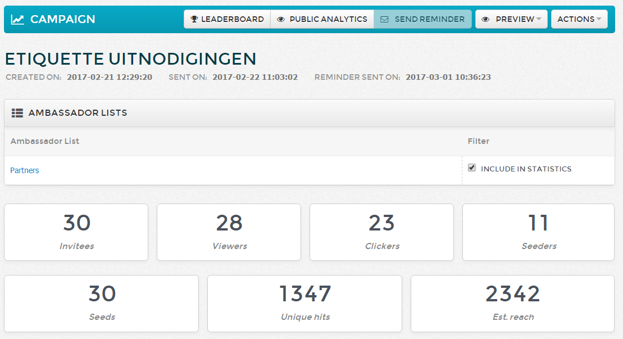

Slide 30
“ WHY AN AMBASSADOR? ”
1 AMBASSADOR
SHARES ON
2,4 NETWORKS
REACHES
317 PEERS
INFLUENCES 4,96% TO CLICK ON BRANDED CONTENT
SOCIAL SEEDER I HOW TO START AN AMBASSADOR PROGRAM

Slide 31
TAKE AWAYS

Slide 32
Always involve management
Give your ambassador program an name
Use advocacy for recruitment also
Make social media message as if the ambassador would write it himself
SOCIAL SEEDER I HOW TO START AN AMBASSADOR PROGRAM

Slide 33
Create a content calendar
Different approach/content internal versus external
Ambassadorship always needs a driver
Give sensible rewardings
Use the canvas
SOCIAL SEEDER I HOW TO START AN AMBASSADOR PROGRAM

Slide 34
?
QUESTIONS
SOCIAL SEEDER I HOW TO START AN AMBASSADOR PROGRAM

Slide 35
Identify, recruit and activate people through a plug and play platform generating digital word-of-mouth with high impact.
Patrick de Pauw
CEO of Social Seeder
+32 (0) 475 84 42 55
patrick@socialseeder.com

